Slide 1
IT306
Module 10
Graphs , Memory Management

Slide 2
Graphs

Slide 3
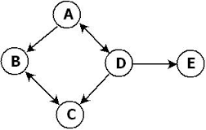
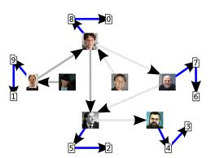
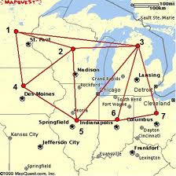
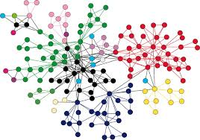
Graphs

Slide 4
Graph Formal Definition and Types
G(V,E) s.t. V={v₁,…,v_{n}}, E = {e₁,…,e_{m}}
Undirected Graph
(unordered edges)
Directed Graph
V={1,2,3,4,5,6,7}
E={(1,2),(1,3),(1,4),(2,3),(2,4),(2,5),(3,5)(3,6),(3,7),(4,5),(5,6),(6,7)}
V={A,B,C,D,E}
E={(A,B),(C,B),(D,C),(D,E),(D,A),(A,D)}

Slide 5
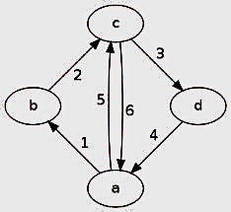
Directed Graph Terminology
Adjacent(joined) vertices: We say that two vertices A and B of a directed graph are adjacent if there is an edge from A to B or vice versa. If such an edge exists, then A and B are its endpoints.
If there is an edge from A to B, A is tail, and B is head.
Path is a sequence of vertices between two vertices e.g., path(A,B) = A,D,C,B.
Length of a path: number of vertices in the path – 1, e.g., length of path(A,B) = 4-1 = 3.
Cycle is a path that begins and ends at the same point, e.g. <a,b,c,a>.
Simple path is a path with no repeating vertices.
Simple cycle = simple path + the origin point.
Outgoing edge, incoming edge.
Notes:
If one can walk from node i to node j along the edges of the graph then we say that there is a path from i to j. If we walked on k edges, then the path has length k.

Slide 6
Undirected Graph Terminology
Adjacent vertices: if there is an edge between two nodes, those nodes are adjacent.
An edge is incident to a vertex if the vertex is one of the two vertices that the edge connects.
Degree: the number of edges that are incident to a certain vertex.
Example: Vertices 1,2 are adjacent.
Example: edge (2,4) is incident to vertex 2.
Other terminologies:
head, tail, path, path length, cycle, simple path, simple cycle.
Example: degree (1) = 3.

Slide 7
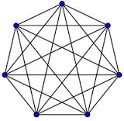
Graph Terminology
Connected-Graph: is a graph is connected if there is a path between every single pair of vertices.
A Complete/Strongly connected-Graph is a graph that has an edge between every single pair of vertices.
A
B
C
D
E
Complete/Strongly Connected graph
Connected graph
Notes:
Strongly connected graph: a graph is called strongly connected if starting at any node i we can reach any other different node j by walking on its edges.

Slide 8
Adjacency Matrix
Adjacency Matrix indicates the connections between vertices of a graph.
Adjacency matrix for a strongly connected graph:
j=0,…,6
columns
i=0,…,6
0 | 1 | 1 | 1 | 1 | 1 | 1
1 | 0 | 1 | 1 | 1 | 1 | 1
1 | 1 | 0 | 1 | 1 | 1 | 1
1 | 1 | 1 | 0 | 1 | 1 | 1
1 | 1 | 1 | 1 | 0 | 1 | 1
1 | 1 | 1 | 1 | 1 | 0 | 1
1 | 1 | 1 | 1 | 1 | 1 | 0
rows

Slide 9
Adjacency List for Directed and Undirected Graphs (Example)
Origins (Tails) | Destinations (Heads)
A | B
B | C
C | A, D
D | E
E | C
A
B
C
D
E
Directed Graph
Origins | Destinations
A | B,C
B | A,C
C | A, B, D, E
D | C, E
E | C,D
A
B
C
D
Undirected Graph
E

Slide 10
Adjacency Matrix
destinations
 | A | B | C | D | E
A | - | 1 | - | - | -
B | - | - | 1 | - | -
C | 1 | - | - | 1 | -
D | - | - | - | - | 1
E | - | - | 1 | - | -
A
B
C
D
origins
E
Directed Graph
Asymmetric

Slide 11
Adjacency Matrix
destinations
A
B
 | A | B | C | D | E
A | - | 1 | 1 | - | -
B | 1 | - | 1 | - | -
C | 1 | 1 | - | 1 | 1
D | - | - | 1 | - | 1
E | - | - | 1 | 1 | -
C
D
origins
E
Undirected Graph
Symmetric

Slide 12

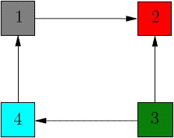

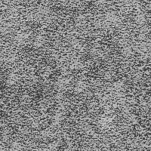
Length-based Path Selection
If one can walk from node i to node j along the edges of the graph then we say that there is a path from i to j.
If we walked on k edges from node i to node j , then the path has length k.
Question: How to find out how many paths with length k exist in a directed graph?
Adjacency Matrix
1 2 3 4
1 2 3 4
1
2
3
4
1
2
3
4
The entry on row i, column j of A^{k} (multiplying matrix A with itself k times) corresponds to the number of paths of length k from node i to node j in the graph.
Notes:
For matrices, we denote by Ak the matrix obtained by multiplying A with itself k times. The entry on row i, column j of A² = A·A corresponds to the number of paths of length 2 from node i to node j in the graph. For Example 2, the square of the adjacency matrix is

Slide 13
Matrix Multiplication

Slide 14

Matrix Multiplication
v₀₀ = (a₀₀ x b₀₀)+ (a₀₁ x b₁₀)+ (a₀₂ x b₂₀) | v₀₁ = (a₀₀ x b₀₁)+ (a₀₁ x b₁₁)+ (a₀₂ x b₂₁) | v₀₂ = (a₀₀ x b₀₂)+ (a₀₁ x b₁₂)+ (a₀₂ x b₂₂) | v₀₃ = (a₀₀ x b₀₃)+ (a₀₁ x b₁₃)+ (a₀₂ x b₂₃)
v₁₀ = (a₁₀ x b₀₁)+ (a₁₁ x b₁₁)+ (a₁₂ x b₂₁) | v₁₁ = (a₁₀ x b₀₁)+ (a₁₁ x b₁₁)+ (a₁₂ x b₂₁) | v₁₂ = (a₁₀ x b₀₂)+ (a₁₁ x b₁₂)+ (a₁₂ x b₂₂) | ?
b₀₀ | b₀₁ | b₀₂ | b₀₃
b₁₀ | b₁₁ | b₁₂ | b₁₃
b₂₀ | b₂₁ | b₂₂ | b₂₃
a₀₀ | a₀₁ | a₀₂
a₁₀ | a₁₁ | a₁₂
x
=
2x3
Row x Col
3x4
Row x Col
2x4
Row x Col
$$\sum_{j=0}^{j=n}{{(a}_{ij} . b_{ji})} , where n:number of columns$$
v_{ij} in the resulting matrix =

Slide 15
Graph traversal algorithms

Slide 16
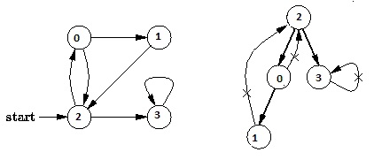
Graph Traversal : DFS for Directed Graphs
DFS (Depth First Search):
Recursive operation
Start at an arbitrary unvisited node.
Use adjacency list and visited list to avoid falling in an infinity loop due to cycles.
DFS visits the child vertices before visiting the sibling vertices; that is, it traverses the depth of any particular path before exploring its breadth.
Notes:
A depth-first search (DFS) is an algorithm for traversing a finite graph.
BFS and DFS are bases for many graphrelated algorithms. Then based on BFS and DFS, topological sort and connectivity of undirected graphs are introduced.

Slide 17
Graph Traversal : DFS for Undirected Graphs
(u,v)
u
A
B
DFS Algorithm (Depth First Search):
Each vertex has three possible colors:
White: vertex is unvisited
Gray: vertex is visited
Black: DFS has finished processing the vertex.
Initially all vertices are white (unvisited). DFS starts in random vertex u and runs as follows:
Mark vertex u (i.e., ’A’) as gray, if u is white, and push it into stack S.
Check all the adjacent unvisited nodes of visited vertex u –alphabetically- (i.e., ‘B’) and push to the top of the stack one at a time.
If there is no path to go from the last node pushed into the stack (i.e., ‘B), mark that vertex as black and backtrack (i.e., pop from the stack). Otherwise, go to step 1 (i.e., call DFS(B) ).
Repeat steps 1~3 until all nodes are colored black.
C
D
Traversal path: { }
F
E
Notes:
The principle of the algorithm is quite simple: to go forward (in depth) while there is such possibility, otherwise to backtrack.

Slide 18
Graph Traversal : DFS for Undirected Graphs
DFS Algorithm (Depth First Search):
Each vertex has three possible colors:
White: vertex is unvisited
Gray: vertex is still in progress
Black: DFS has finished processing the vertex.
u
A
(u,v)
A
B
Visited path: {A}
C
D
F
E

Slide 19
Graph Traversal : DFS for Undirected Graphs
DFS Algorithm (Depth First Search):
Each vertex has three possible colors:
White: vertex is unvisited
Gray: vertex is still in progress
Black: DFS has finished processing the vertex.
u
B
A
A
B
Visited path: {A,B}
(u,v)
C
D
F
E

Slide 20
Graph Traversal : DFS for Undirected Graphs
DFS Algorithm (Depth First Search):
Each vertex has three possible colors:
White: vertex is unvisited
Gray: vertex is still in progress
Black: DFS has finished processing the vertex.
C
B
A
A
B
Visited path: {A,B,C}
u
C
D
(u,v)
F
E

Slide 21
Graph Traversal : DFS for Undirected Graphs
DFS Algorithm (Depth First Search):
Each vertex has three possible colors:
White: vertex is unvisited
Gray: vertex is still in progress
Black: DFS has finished processing the vertex.
E
C
B
A
A
B
Visited path: {A,B,C,E}
C
D
u
(u,v)
F
E

Slide 22
Graph Traversal : DFS for Undirected Graphs
DFS Algorithm (Depth First Search):
Each vertex has three possible colors:
White: vertex is unvisited
Gray: vertex is still in progress
Black: DFS has finished processing the vertex.
D
E
C
B
A
A
B
Visited path: {A,B,C,E,D}
u
C
D
F
E

Slide 23
Graph Traversal : DFS for Undirected Graphs
DFS Algorithm (Depth First Search):
Each vertex has three possible colors:
White: vertex is unvisited
Gray: vertex is still in progress
Black: DFS has finished processing the vertex.
E
C
B
A
A
B
Visited path: {A,B,C,E,D}
Backtracking
D = stack.pop()
C
D
u
F
E

Slide 24
Graph Traversal : DFS for Undirected Graphs
DFS Algorithm (Depth First Search):
Each vertex has three possible colors:
White: vertex is unvisited
Gray: vertex is still in progress
Black: DFS has finished processing the vertex.
C
B
A
A
B
Visited path: {A,B,C,E,D}
Backtracking
u
E = stack.pop()
C
D
F
E

Slide 25
Graph Traversal : DFS for Undirected Graphs
DFS Algorithm (Depth First Search):
Each vertex has three possible colors:
White: vertex is unvisited
Gray: vertex is still in progress
Black: DFS has finished processing the vertex.
F
C
B
A
A
B
Visited path: {A,B,C,E,D,F}
u
C
D
(u,v)
F
E

Slide 26
Graph Traversal : DFS for Undirected Graphs
DFS Algorithm (Depth First Search):
Each vertex has three possible colors:
White: vertex is unvisited
Gray: vertex is still in progress
Black: DFS has finished processing the vertex.
F
C
B
A
A
B
Visited path: {A,B,C,E,D,F}
Backtracking
F = stack.pop()
C
D
F
E
u

Slide 27
Graph Traversal : DFS for Undirected Graphs
DFS Algorithm (Depth First Search):
Each vertex has three possible colors:
White: vertex is unvisited
Gray: vertex is still in progress
Black: DFS has finished processing the vertex.
C
B
A
A
B
Visited path: {A,B,C,E,D,F}
Backtracking
u
C = stack.pop()
C
D
F
E

Slide 28
Graph Traversal : DFS for Undirected Graphs
DFS Algorithm (Depth First Search):
Each vertex has three possible colors:
White: vertex is unvisited
Gray: vertex is still in progress
Black: DFS has finished processing the vertex.
u
B
A
A
B
Visited path: {A,B,C,E,D,F}
Backtracking
B = stack.pop()
C
D
F
E

Slide 29
Graph Traversal : DFS for Undirected Graphs
DFS Algorithm (Depth First Search):
Each vertex has three possible colors:
White: vertex is unvisited
Gray: vertex is still in progress
Black: DFS has finished processing the vertex.
u
A
A
B
Visited path: {A,B,C,E,D,F}
Backtracking
A = stack.pop()
C
D
Traversal is complete now
F
E
Complexity: O(V+E) where V: total number of vertices, E: total number of edges

Slide 30
Applications of DFS
Detecting cycle in a graph
Path finding
Job scheduling based on the given dependencies among jobs.
Solving puzzles like mases.
Finding strongly connected components of a graph.
Other

Slide 31
Graph Traversal : BFS
BFS (Breadth First Search)
Starting at A and mark A as “visited”.
A
B
C
D
Traversal Order: { }
E
Finds the shortest cut between the origin vertex and any other vertex.
Notes:
U is A in the beginning.

Slide 32
Graph Traversal : BFS
BFS (Breadth First Search)
Process all edges (u,v) from A = u, where distance from A is 1.
Mark B as visited.
A
B
C
D
Traversal Order: {A}
E
Finds the shortest cut between the origin vertex and any other vertex.
Notes:
U is A in the beginning.

Slide 33
Graph Traversal : BFS
BFS (Breadth First Search)
Process each edge (u,v) from B = u, where distance from A is 2.
(B,C), (B,D)
A
B
C
D
Traversal Order: {A,B}
E
A
B
Traversal Order: {A,B,C,D}
C
D
E
Notes:
U is A in the beginning.

Slide 34
Graph Traversal : BFS
BFS (Breadth First Search)
Process each edge (u,v) from C,D, where distance from A is 3.
(C,E)
A
B
C
D
Traversal Order: {A,B,C,D}
E
A
B
Traversal Order: {A,B,C,D,E}
C
D
BFS Finds the shortest cut between the origin vertex and any other vertex.
E
Notes:
U is A in the beginning.

Slide 35
Exercise
A
B
BFS (Breadth First Search):
Start at E
C
D
E
F

Slide 36
Applications of BFS
Shortest Path and MST
Social Networking websites
Broadcasting in Networks
Cycle Detection in undirected graphs
Path finding
Other

Slide 37
Other Graph Traversal Aglos
Greedy Algorithms
Kruskal’s Algorithm for Minimum Spanning Tree (MST)
Dijkstra’s Algorithm (shortest path)
What is a Greedy Algorithm?
“A greedy algorithm is an algorithmic paradigm that follows the problem solving heuristic of making the locally optimal choice at each stage with the hope of finding a global optimum.” Wikipedia
Notes:
Kruskal's algorithm is a minimum-spanning-tree algorithm which finds an edge of the least possible weight that connects any two trees in the forest.

Slide 38
Kruskal’s Algorithm
Connected Graph with weighted edges
Minimum spanning tree
3
D
G
7
9
A
F
3
D
G
3
5
7
9
A
F
2
C
8
3
5
4
1
B
E
2
C
8
4
1
3
B
E
3
Pick the smallest edge

Slide 39
Kruskal’s Algorithm
Repeatedly look for the smallest edges that don’t create a cycle
Connected Graph with weighted edges
You can choose any of the edges with the same weight.
Minimum spanning tree
3
D
G
7
9
3
D
G
A
F
7
3
5
A
9
F
3
5
2
C
8
4
1
2
C
4
1
8
B
E
3
B
E
3
Two trees (they are not connected)

Slide 40
Kruskal’s Algorithm
Repeatedly look for the smallest edges that don’t create a cycle
Connected Graph with weighted edges
You can choose any of the edges with the same weight.
Minimum spanning tree (MST)
3
D
G
7
9
3
D
G
A
F
7
3
5
A
9
F
3
5
2
C
8
4
1
2
C
4
1
8
B
E
3
B
E
3
Edge AC is added to the MST.

Slide 41
Kruskal’s Algorithm
Repeatedly look for the smallest edges that don’t create a cycle
Connected Graph with weighted edges
Minimum spanning tree (MST)
3
D
G
7
9
3
D
G
A
F
7
3
5
A
9
F
3
2
C
8
4
1
2
C
B
E
1
3
B
E
This is MST
Keep adding until all the nodes are in the same tree.

Slide 42
Kruskal’s Algorithm Complexity
3
D
G
7
9
A
F
3
2
C
1
B
E
This is MST
Complexity = O(E logV) or O(E logE)
Reason: E is at most V², and logE = log V²=2 log V => O(logE)= O(log V)

Slide 43
Java Implementation Of Directed Graph Exercise: Study the Code
G(V,E)
Directed Graph
DirectedGraph.java
DirectedGraphApplication.java

Slide 44
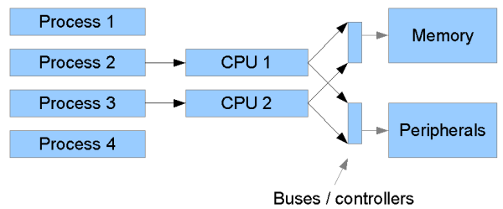
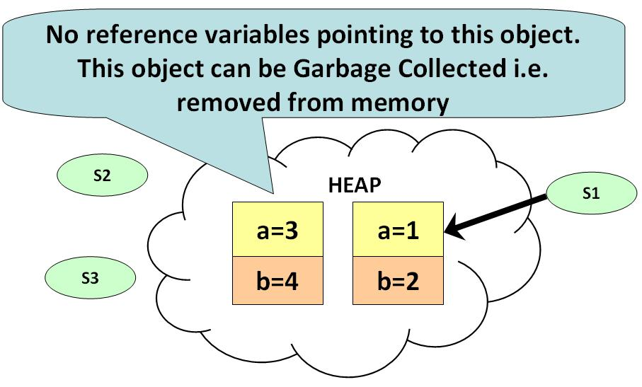
Memory Management in Java
Memory management to optimize performance
Heap
Nursery
Old Space
Garbage Collection
Notes:
Memory is one of the first things to look at when you want to optimize performance. If you have any disk swapping, that will have a serious impact on performance. Make sure that your server has an optimal amount of memory and that your JVM is tuned to use it.
Heap is used to keep complex objects. Heap is slower than stack.

Slide 45
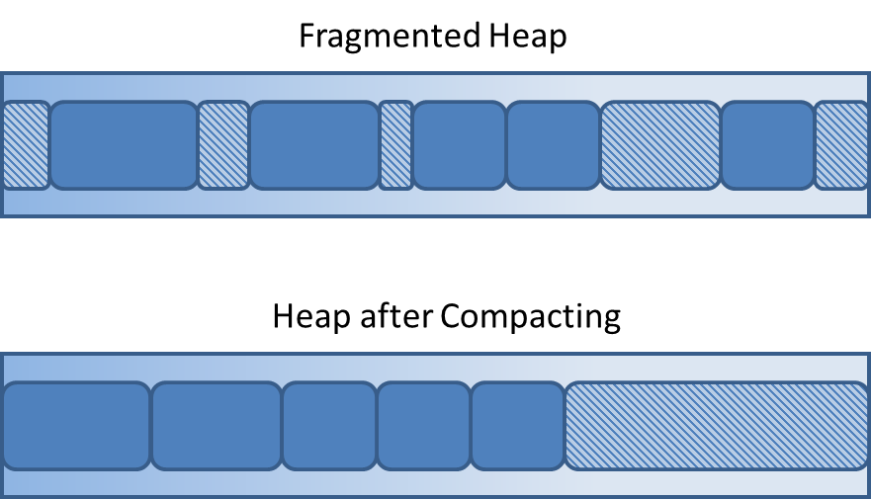
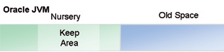
Heap
Heap is a memory set aside for dynamic memory allocation.
Heap is divided into two areas:
Nursery: used for allocation of new objects. When it becomes full, garbage is collected by running a special young collection, where all objects that have lived long enough in the nursery are promoted (moved) to the old space, thus freeing up the nursery for more object allocation.
Old Space: When the old space becomes full, garbage is collected there, a process called on old collection.
Java objects reside in Heap area. The heap is created when the JVM starts up and may increase/decrease in size when the application runs.
A “single-generational heap” is a heap without a nursery.
Notes:
The reasoning behind a nursery is that most objects are temporary and short lived. A young collection is designed to be swift at finding newly allocated objects that are still alive and moving them away from the nursery. Typically, a young collection frees a given amount of memory much faster than an old collection or a garbage collection of a single-generational heap (a heap without a nursery).
JVM uses more memory than just the heap.

Slide 46
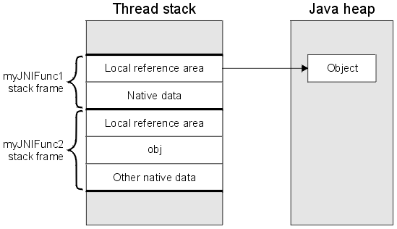
Object Allocation
Small objects
object
object
Notes:
During object allocation, small objects are allocated in thread local areas (TLAs). The thread local areas are free chunks reserved from the heap and given to a Java thread for exclusive use.
When the TLA becomes full, the thread simply requests a new TLA. The TLAs are reserved from the nursery if such exists, otherwise they are reserved anywhere in the heap.
Large objects that don’t fit inside a TLA are allocated directly on the heap. When a nursery is used, the large objects are allocated directly in old space.

Slide 47
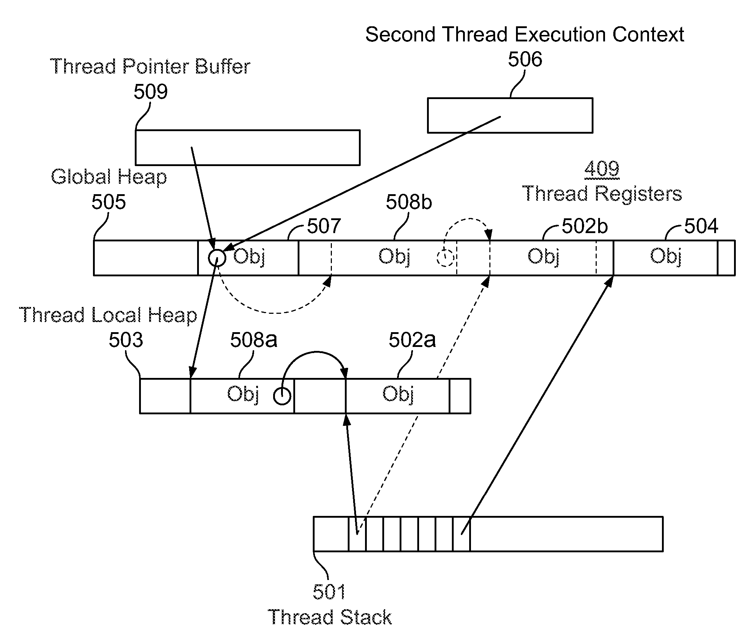
Big Picture

Slide 48
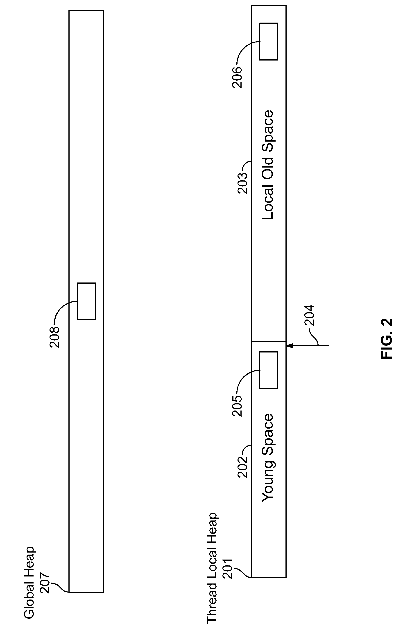
Thread Local Heap vs. Global Heap

Slide 49
Garbage Collection (GC)
A process that releases memory from unreferenced objects. During the garbage collection, objects that are no longer used are cleared, thus making space for new objects. Some GC Models are explained below:
The Mark and Sweep Model: Consists of 2 phases:
Mark phase: During the mark phase all objects that are reachable from Java threads, native handles and other root sources are marked as alive, as well as the objects that are reachable from these objects and so forth. This process identifies and marks all objects that are still used, and the rest can be considered garbage.
Sweep phase: During the sweep phase the heap is traversed to find the gaps between the live objects. These gaps are recorded in a free list and are made available for new object allocation.
Generational Garbage Collection
A garbage collection strategy which uses a nursery is called a generational garbage collection strategy, or simply generational garbage collection
Compaction
Objects that are allocated next to each other will not necessarily become unreachable (“die”) at the same time. This means that the heap may become fragmented after a garbage collection, so that the free spaces in the heap are many but small, making allocation of large objects hard or even impossible.
Free spaces that are smaller than the minimum thread local area (TLA) size can not be used at all, and the garbage collector discards them as dark matter until a future garbage collection frees enough space next to them to create a space large enough for a TLA.

Slide 50
References
https://docs.oracle.com/cd/E13150_01/jrockit_jvm/jrockit/geninfo/diagnos/garbage_collect.html
http://www.geeksforgeeks.org/greedy-algorithms-set-2-kruskals-minimum-spanning-tree-mst/
https://docs.oracle.com/cd/E13150_01/jrockit_jvm/jrockit/geninfo/diagnos/garbage_collect.html#wp1086732

